Slide 1

POOL Meeting 02/10/2015
Swagat Sahu
Advisor: Professor Nathan C. Gianneschi
Department of Chemistry & Biochemistry
University of California, San Diego

Slide 2
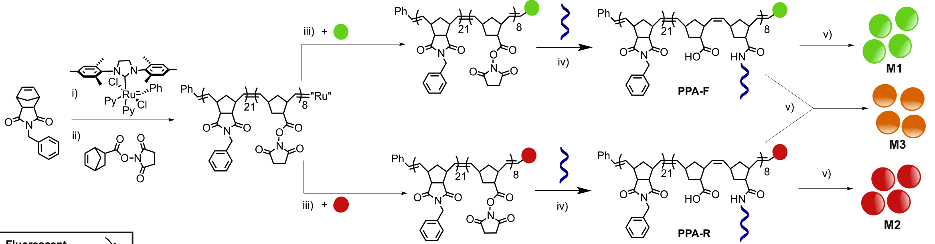
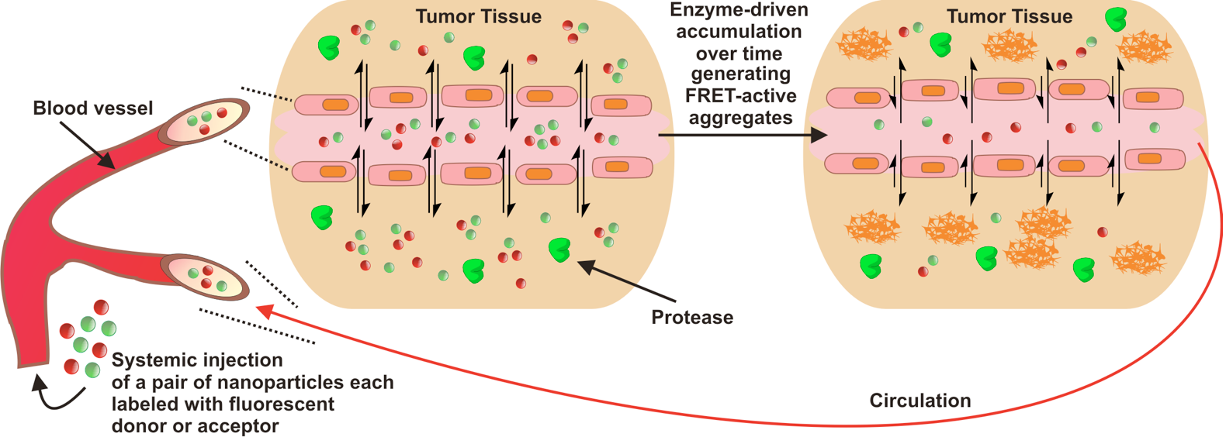
MMP-9 responsive nanoparticles for in vivo tumor imaging
Chien, M.-P., Thompson, M. P., Barback, C. V., Hall, D. J. and Gianneschi, N. C. Advanced Materials, 2013, 25: 3599.

Slide 3
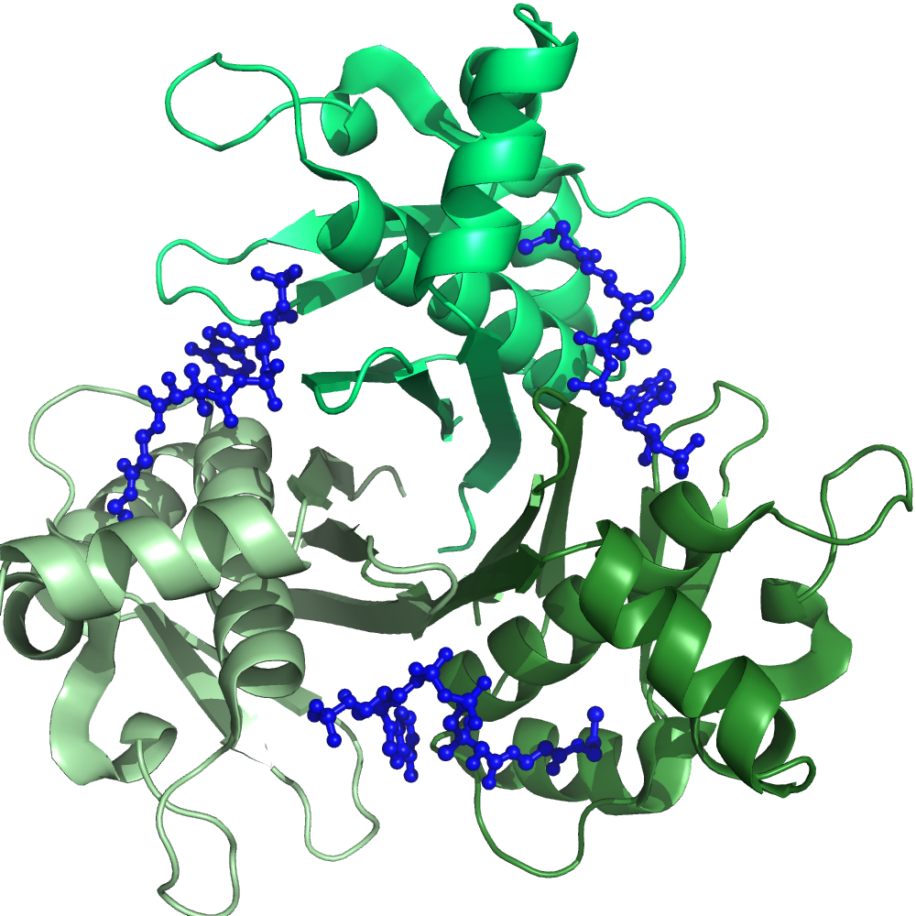
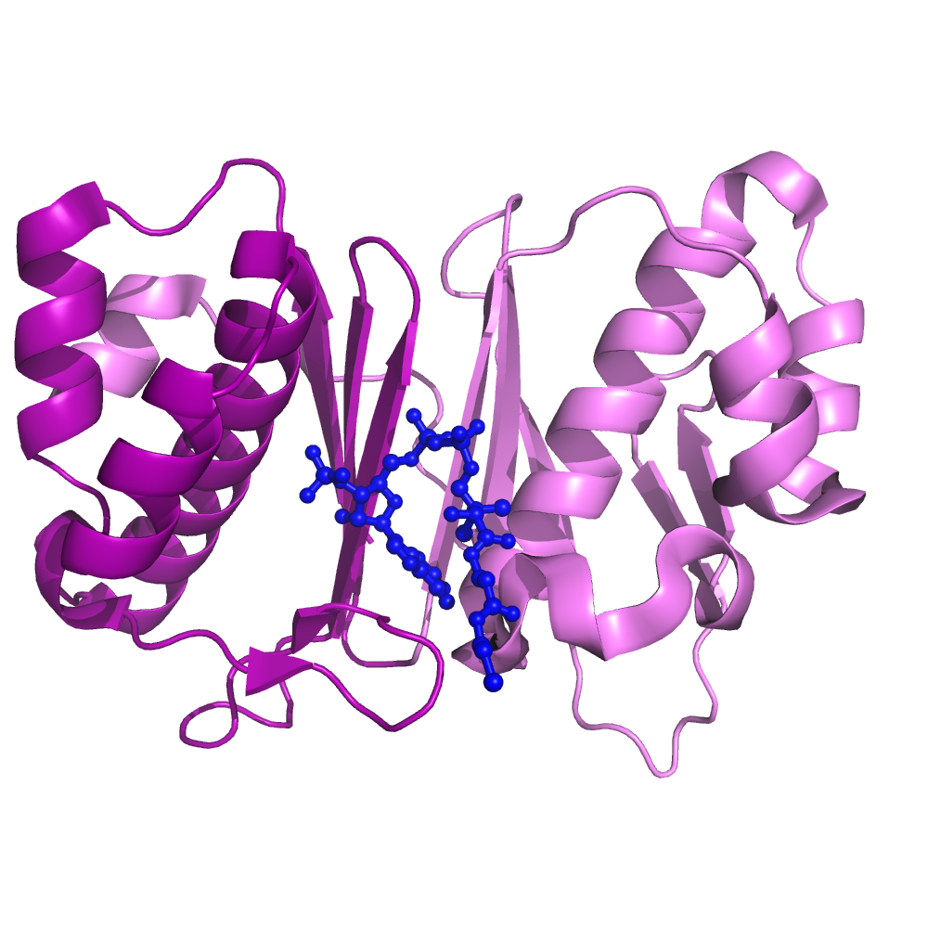
Structural differences between PPTases allow for orthogonal labeling
B. subtilis Sfp
pseudodimer
S. coelicolor AcpS
homotrimer

Slide 4
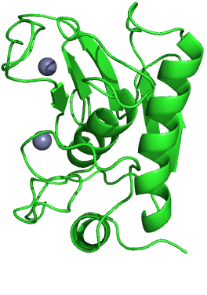
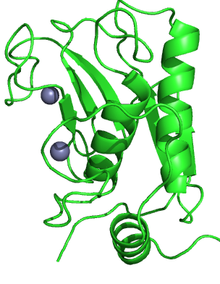
Can POOL optimize orthogonal peptide substrates in a system with less structural diversity
Collegenase Fibroblast
(MMP-1) Catalytic Domain
Gelatinase A
(MMP-2) Catalytic Domain

Slide 5
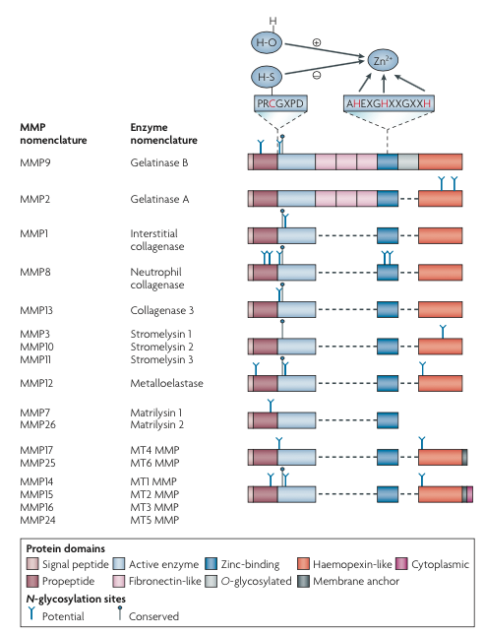
Matrix Metalloproteinases
23 MMPs in humans
Zinc-dependent protein & peptide hydrolases
Main role: extracellular matrix processing
Cleave many of the same sequences, but there is some sequence selectivity between classes.
Tallant, C. et al. Biochimica et Biophysica Acta 2010, 1803, 20.
Hu, J. et al. Nature Review Drug Discovery 2007, 6, 480.
Notes:
All MMPs have conserved sequence in catalytic domain that has 3 histidines to bind Zn and a glutamic acid that acts as a general acid/base. 3 types of MMPs: gelatinases, collagenases & stromelysins. Pro-domain so when secreted from cells are inactive. Pro-domain has a conserved cysteine that interacts with Zn and blocks active site.

Slide 6
Relative rates of reactivity with known sequences
Selectivity for 1 MMP
Selectivity for Class
Non-Selective
Negase , MMP Inhibitors in Cancer Therapy

Slide 7

Membrane Controls Before Meeting with Peter
Peptide Synthesizer
Makes 30x KPLGLAG-Rink
10 x KPLGLAG Without Rink
Membrane
Membrane
Confirm synthesis by MALDI
I manually
add dye
TFA
Membrane
Membrane
Treat with
MMP-9
Monitor for fluorescence decrease
Membrane

